Slide 1

MINI PROJECT TOPIC:VISION BASED ACCESS FOR FINANCIAL TRANSACTIONS
UNDER THE GUIDANCE OF
MR. HANUMANTH RAO
PRESENTED BY-GROUP 21
B.ASHOK -21P61A0521
D.LIKITH -22P65A0559
D.VIJAY -21P61A0560

Slide 2
CONTENTS
TITTLE
ABSTRACT
INTRODUCTION
LITERATURE SURVEY
PROBLEM STATEMENT
OBJECTIVES
SOFTWARE AND HARDWARE REQIREMENTS
PROPOSED METHODLOGY
MODULES
IMPLEMENTATION
RESULTS
REFERENCES

Slide 3
ABSTRACT
This project focuses on creating a web-based ATM simulator that integrates facial recognition technology for user authentication. The simulator is designed to replicate the functionality of traditional ATMs, enabling users to perform various banking tasks—such as checking account balances, transferring funds, and withdrawing cash—through a secure and intuitive interface.
By leveraging advanced face recognition technology, the project aims to enhance security and streamline the user experience, eliminating the need for physical cards or PINs. The simulator will employ modern web development frameworks and face recognition APIs to ensure accurate and efficient authentication processes.

Slide 4
INTRODUCTION
Facial recognition in ATMs is a modern technology that allows people to access their bank accounts using their faces instead of just a card and PIN. When a user approaches the ATM, the machine takes a quick picture of their face and compares it to a database of registered users. If it matches, the user can complete their transaction.

Slide 5
LITERATURE SURVEY
S.No | tittle | author | year | methodology | conclusion | Limitations | Future scope
1 | Eigenfaces for Recognition | Turk & Pentland | 1991 | PCA (Principal Component Analysis) | Introduced a holistic approach for face recognition | Sensitive to lighting, pose variations, and occlusions | Explore more robust features for real-world conditions
2 | Fisherfaces vs Eigenfaces | Belhumeur et al. | 1997 | LDA (Linear Discriminant Analysis) vs PCA | Fisherfaces provide better discrimination under varying lighting | Susceptible to noise and requires larger datasets | Extend to handle non-frontal images and expression variations

Slide 6
S.No | tittle | author | year | methodology | conclusion | limitations | Future scope
3 | Labeled Faces in the Wild: A Database for Studying Face Recognition in Unconstrained Environments | Huang et al. | 2008 | Dataset Benchmark | Provided a large-scale dataset for face recognition "in-the-wild" | Dataset has noise and lacks diversity in pose and expression | Improve dataset quality and include more diverse conditions
4 | DeepFace: Closing the Gap to Human-Level Performance | Taigman et al. | 2014 | Deep Neural Networks (DNN) | Achieved near-human accuracy in face recognition | Requires significant computational resources and data | Improve efficiency and reduce reliance on massive datasets
5 | FaceNet: A Unified Embedding for Face Recognition | Schroff et al. | 2015 | Deep Learning with Triplet Loss | Improved face verification and clustering using unified embedding | High computational cost, memory-intensive | Optimize embedding techniques for real-time performance

Slide 7
S.No | Tittle | author | year | methodology | conclusion | limitations | Future scope
6 | Deep Learning for Face Recognition | Parkhi et al. | 2015 | Convolutional Neural Networks (CNNs) | High accuracy achieved using deep learning architecture (VGGFace) | Not suitable for real-time systems due to computational cost | Enhance models for faster, real-time processing
7 | Face Recognition: A Literature Survey | Zhao et al | 2003 | Survey of various methods | Comprehensive survey of challenges posed by pose, illumination, and expression | No single method addresses all challenges effectively | Focus on developing methods to handle all variations (PIE)
8 | Adversarial Attacks and Defenses in Face Recognition | Wang et al. | 2018 | Adversarial Training, GANs | Explored vulnerabilities of face recognition systems to adversarial attacks | Defense methods are computationally expensive | Develop lightweight and efficient adversarial defenses

Slide 8
PROBLEM STATEMENT
Facial recognition technology in ATMs aims to provide a secure and convenient way for users to access their accounts.
current systems face challenges such as low accuracy in different lighting and angles, concerns about user privacy, and potential security risks from spoofing attempts. Additionally, not all demographic groups are represented equally in the training data, leading to biases in performance .

Slide 9
OBJECTIVES
Enhance Security: Use facial recognition to make transactions safer by verifying user identities.
Improve User Experience: Allow users to access their accounts without needing cards or PINs, making it quicker and easier.
Integrate with Existing Systems: Ensure that the facial recognition technology works smoothly with current ATM infrastructures.

Slide 10
SOFTWARE AND HARDWARE REQUIREMENTS
MINIMUM HARDWARE REQUIREMENTS
Intel Core i3 or equivalent processor
8 GB RAM
256 GB SSD
720p HD webcam for basic facial recognition testing.
SOFTWARE REQUIREMENTS
Vs code ide
Frontend Technologies: HTML, CSS, Javascript
Backend Technologies: Python, PHP
Libraries : face recognition and dlib
Database Management System (DBMS): MySQL

Slide 11
PROPOSED METHODOLOGY
The project involves creating a web-based ATM simulator with facial recognition for secure user authentication. The development includes designing an intuitive graphical interface using HTML, CSS, and JavaScript, and integrating facial recognition.
On the backend,a structured database stores user profiles and transaction history with strong encryption for data protection. After integration and thorough testing, the application is deployed, monitored, and maintained for performance and security.

Slide 12
Frontend: Set up a development environment for HTML, CSS, and JavaScript.
Backend: Set up a python development environment with necessary libraries for web server and facial recognition.
Dependencies
Frontend: Use libraries like face-api.js for facial recognition.
Backend: Use PHP for handling server-side logic and for database interactions.
Facial Recognition Integration
Integrate a facial recognition library in python, such as OpenCV ,face recognition models and dlib.

Slide 13
MODULES
1.User Registration Module
To enroll new users securely.
Collects and stores user data including visual information such as facial features, retina scans, or fingerprint images. This module may use a camera or biometric sensor.
2.Authentication Module
To verify a user's identity before allowing access.
Uses facial recognition, fingerprint scanning, or other visual-based biometric verification to confirm a user’s identity. It compares the live input with the stored data from the registration module.

Slide 14
3. Transaction Management Module
To handle all financial transactions securely.
Processes user requests like fund transfers, balance inquiries, or payments, but only if the user is authenticated. This module is tightly integrated with the authentication system to ensure secure access.
4.Security and Monitoring Module
To enhance system security and track unusual activity.
Continuously monitors transactions for irregular patterns, potential fraud, or unauthorized access. It can alert users or admins if something suspicious is detected.

Slide 15
6. User Interface (UI) Module
To provide an easy and user-friendly interface.
Offers a visual interface for users to interact with the system. It includes login screens, transaction forms, and error notifications. It also guides users during the registration and authentication process.
7.Notification Module
To notify users and admins of important events.
Sends notifications via SMS, email, or app notifications regarding transactions, authentication events, or any potential security issues.

Slide 16

RESULTS:

Slide 17
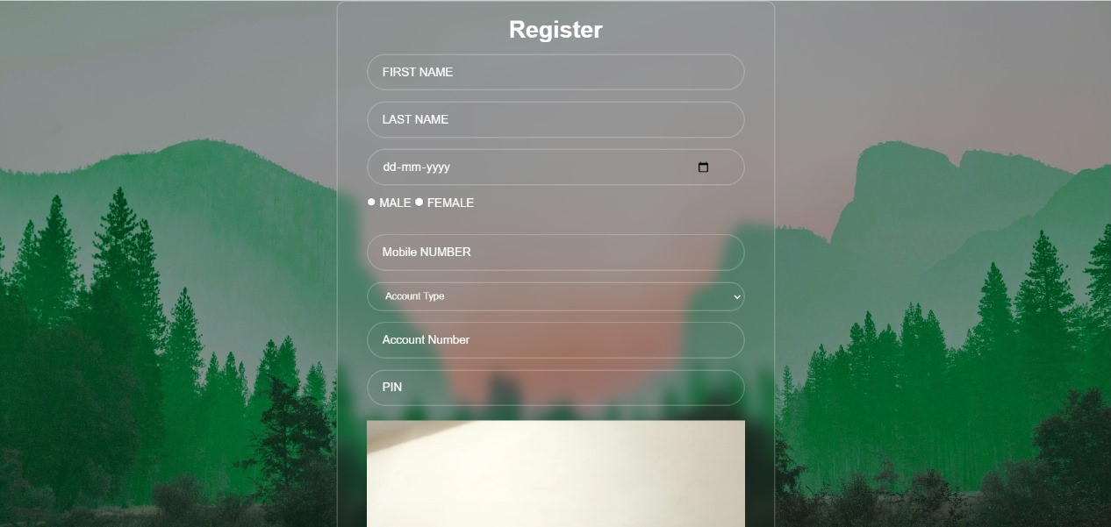

Slide 18
REFERENCES
1. Eigenfaces for Recognition – ResearchGate
2. Fisherfaces vs Eigenfaces – ResearchGate
3. FaceNet - Google Research
4. LBP for Face Recognition – ResearchGate
5. Face Recognition Survey – IEEE
6. Adversarial Attacks on Face Recognition – ResearchGate
7. Bias in Facial Recognition - ResearchGate

